Slide 1
Module 7: Azure Machine Learning Model Management and Deployment

Slide 2
Data Science Building Blocks Project
Prepare data, train models
Hyperparameter tuning
Experimentation and pipelines
Deployment
Monitor and Retrain
Classical ML
Deep learning
Data
Data stores
Data sets
Managed Compute
Azure Machine Learning compute cluster

Slide 3
Data Science Building Blocks Project
Prepare data, train models
Hyperparameter tuning
Experimentation and pipelines
Deployment
Monitor and Retrain
Classical ML
Deep learning
Data
Data stores
Data sets
Managed Compute
Azure Machine Learning compute cluster

Slide 4
Data Science Building Blocks Project
Prepare data, train models
Hyperparameter tuning
Experimentation and pipelines
Deployment
Monitor and Retrain
Classical ML
Deep learning
Data
Data stores
Data sets
Managed Compute
Azure Machine Learning compute cluster

Slide 5
Data Science Building Blocks Project
Prepare data, train models
Hyperparameter tuning
Experimentation and pipelines
Deployment
Monitor and Retrain
Classical ML
Deep learning
Data
Data stores
Data sets
Managed Compute
Azure Machine Learning compute cluster

Slide 6
Model management
Create/Retrain Model
Enable DevOps with full CI/CD integration with VSTS
Register Model
Track model versions with a central model registry
Monitor
Oversea deployments through Azure AppInsights

Slide 7
Deploy Azure ML models at scale
Azure Machine Learning Service
Cognitive Services
Model Registry
Your IDE
Image Registry
Image Registry
Cloud Service
Azure Machine Learning Experimentation
Heavy Edge
Register Model
Scoring File
Create & Register Image
Deployment & Model Monitoring
Light Edge
External Model

Slide 8
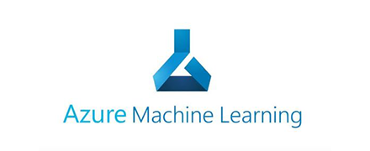
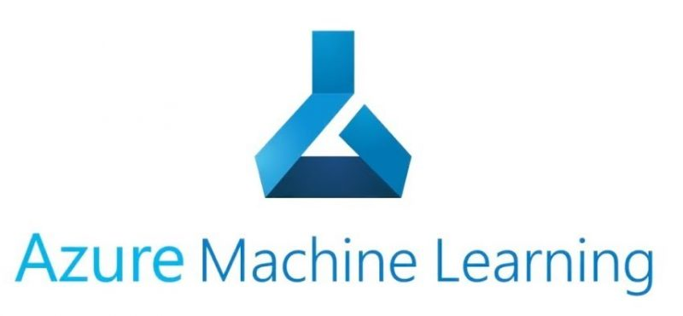
train.py
Conda_dependencies.yml
Azure Managed Compute
Subset data
Training script
Data sets
Environment
Compute
train_sumit.py
Hyperdrive Run configuration
Search grid
logs
Experiment
Submit run
Parent run
Child runs

